Slide 1
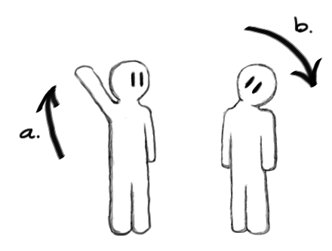
How To Play
a. Mannequin raises
their hand...
b. User tilts their
head in the same
direction.

Slide 2
Physical
Movement
Mechanics
Design Pillars
Context
Sensitive
Design
Presence
Intuitive
Control

Slide 3
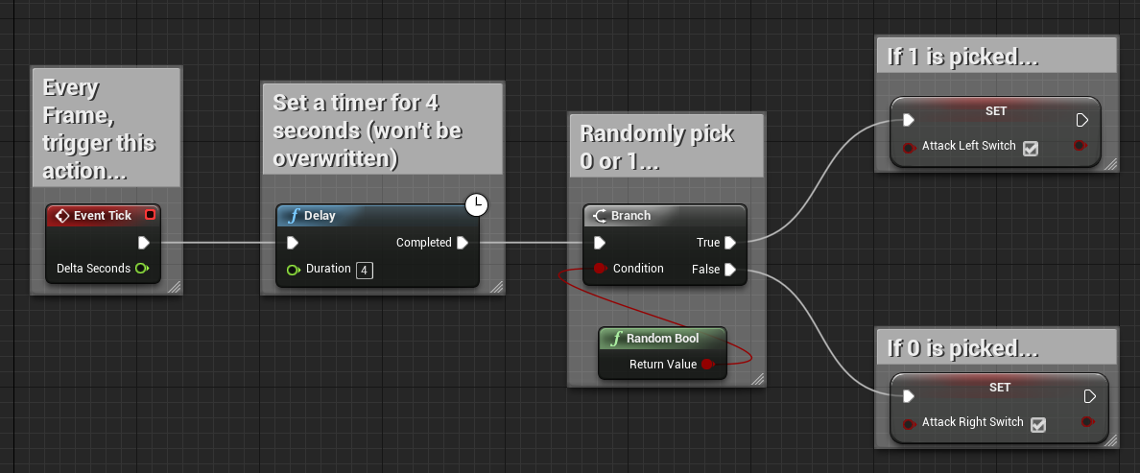
“Attack” Selection Logic

Slide 4
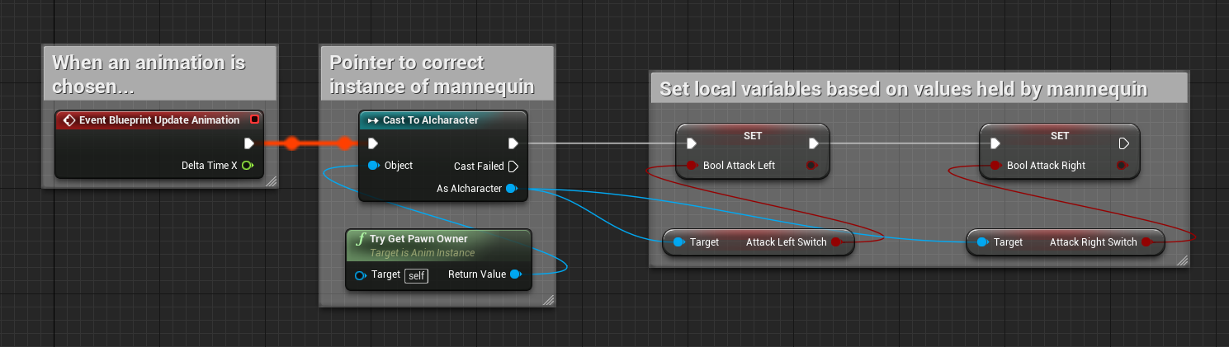
Animation Trigger Logic

Slide 5
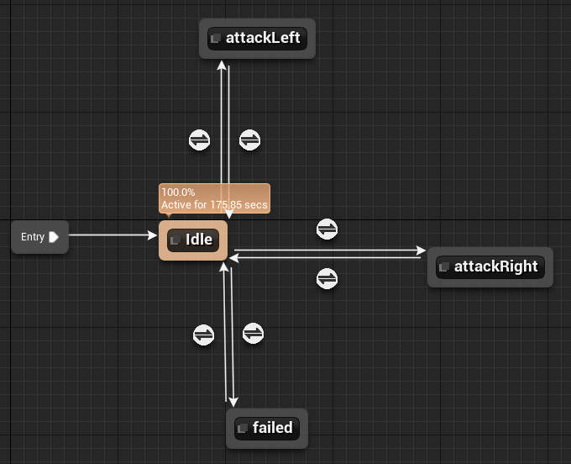
State Machine

Slide 6
(right)
+
X axis
(up)
+
Y Axis
Head Mounted Display
-
(left)
-
(down)
+
-
(right)
(left)
Z Axis

Slide 7
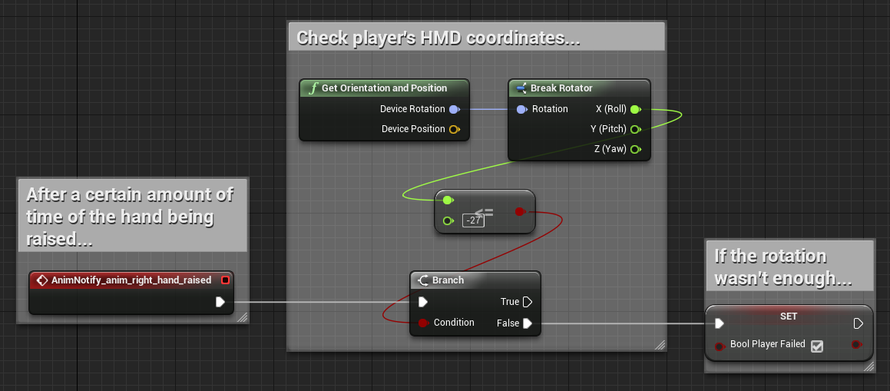
Head Position Logic

Slide 8
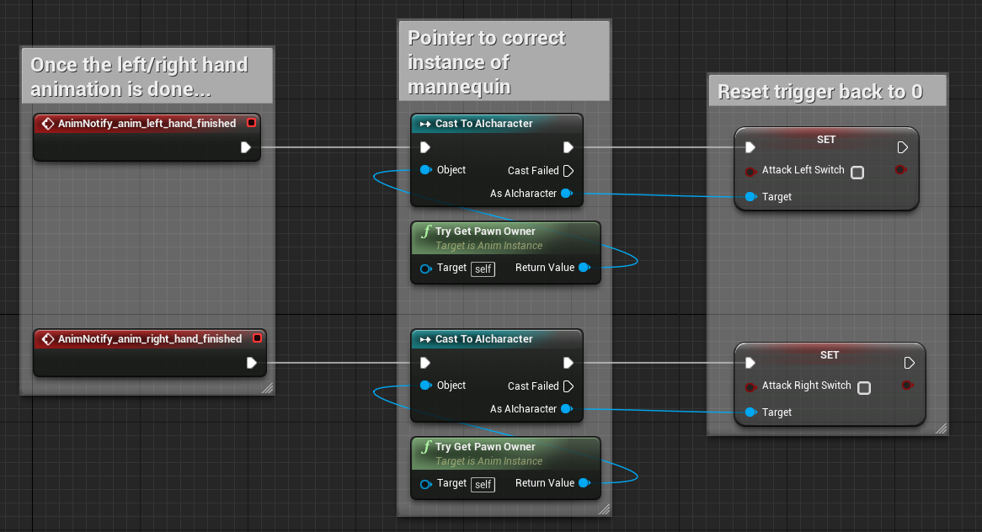
Animation Trigger Reset Logic

Slide 9
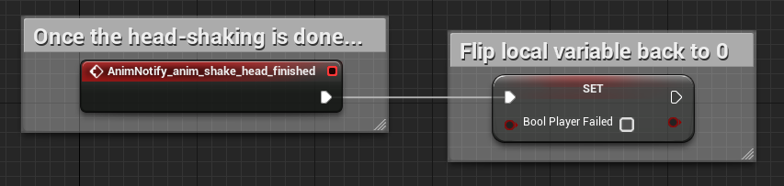
Failure Trigger Reset Logic
And now for some theory...

Slide 10
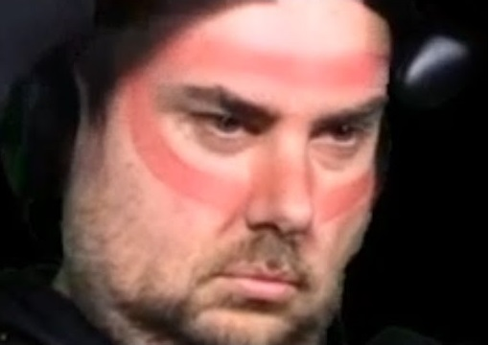
...But is it all worth it?
Advantages vs. Disadvantages?
VR vs. Normal Setup?
Pros vs. Cons
Natural Camera Movement
Enhanced User Experience
Intuitive Controls
VR Sickness
Hardware Requirements
“Stuck” In First Person
Locomotion Issues

